Slide 1


PREDICTING PRODUCER PRICE INDEX IN THE EUROPEAN UNION

Slide 2
WHAT IS INFLATION
Inflation refers to a general progressive increase in prices of goods and services in an economy
When the general price level rises, each unit of currency buys fewer goods and services; consequently, inflation corresponds to a reduction in the purchasin power of money.
The opposite of inflation is deflation, a sustained decrease in the general price level of goods and services.
The common measure of inflation is the inflation rate.

Slide 3
INFLATION FOR CUSTOMERS … BUT ALSO FOR COMPANIES
HICP (HARMONIZED INDEX OF CONSUMER PRICES)
Measures change in the prices of a basket of goods and services that are typically purchased by specific groups of households.
PPI (PRODUCER PRICE INDEX)
Producer price indices in manufacturing measure the rate of change in prices of products sold as they leave the producer

Slide 4
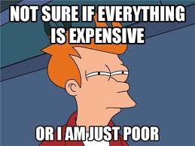
WHY TO PUT FOCUS ON PRODUCER PRICE INDEX
Manager of industrial company
Price increases of commodities impact structure costs and also margins.
Businesses often enter into long-term contracts with suppliers (clauses in the contract that adjusts the cost by external indicators, such as the PPI)
Manager of intermediate goods / retailer company
Sooner or later, they will be impacted by increase of prices in the supply chain. Increases of prices impact structure costs and also margins.
Customers
?

Slide 5
COST STRUCTURE. IMPACT OF COMMODITIES (I)
COMMODITIES
COST STRUCTURE
ENERGY
MATERIALS
WAGES
SUPPLIES
SERVICES
ENERGY
MATERIALS
CRUDE OIL
NATURAL GAS
COAL
ELECTRICITY
STEEL
COPPER
ALUMINUM

Slide 6
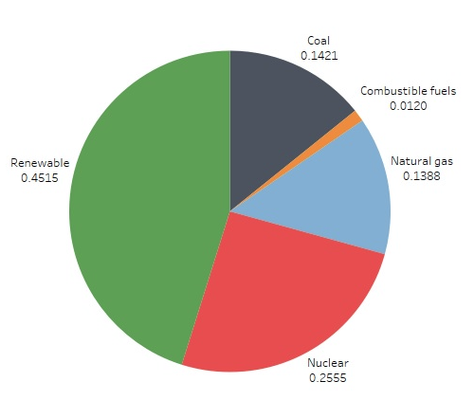
COST STRUCTURE. IMPACT OF COMMODITIES (II)
ELECTRICITY
70% of generation mix in EU in 2021 is based on renewable sources and nuclear. Only 30% is generated using commodities.
Big impact on PPI by itself.
USE OF ONLY 7 COMMODITIES AS EARLY INDICATORS
The basic materials included are the most important in industry. Better predictions should use more indicators, but the premise is to keep the model simple.

Slide 7
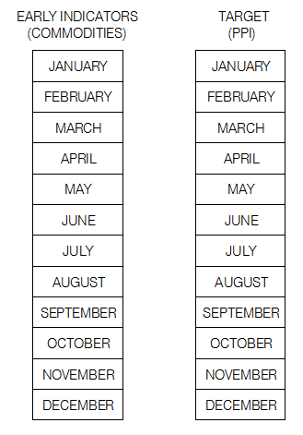
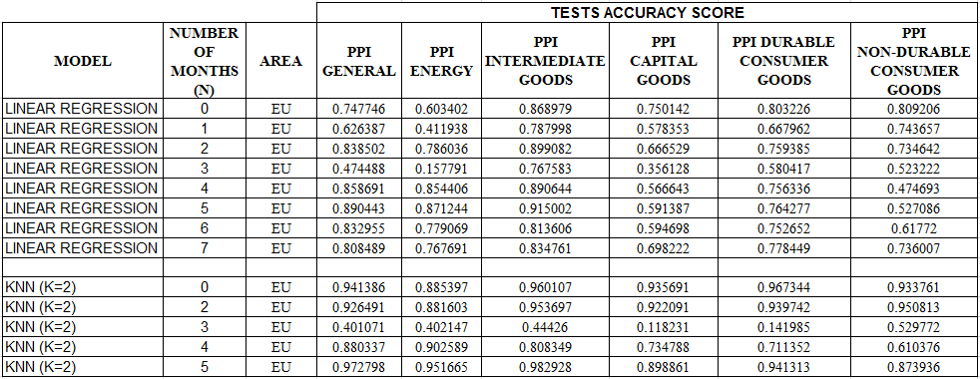
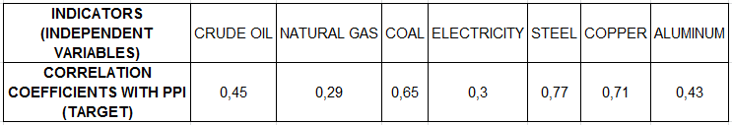
USING CURRENT COMMODITY PRICES TO TRY TO PREDICT THE FUTURE
Use of commodities as early indicators (current month values to predict PPI in the next months), not as variables related with current PPI (N=0).
N=0
N=2
N=5

Slide 8
USING CURRENT COMMODITY PRICES TO TRY TO PREDICT THE FUTURE
CONCLUSIONS
Best results achieved when using values of current month to predict PPI (general) two month later (N=2) or 5 months (N=5). KNN model has the best scores.
Worse scores for other values of N (N=1 or N=3)
Increase of commodities prices does not affect immediately PPI. It takes some time (months) to impact economy and reflect in the PPI.
Model also useful to predict PPI of industrial subsectors (using KNN model) and countries.

Slide 9
THANKS FOR YOUR ATTENTION

